Slide 1
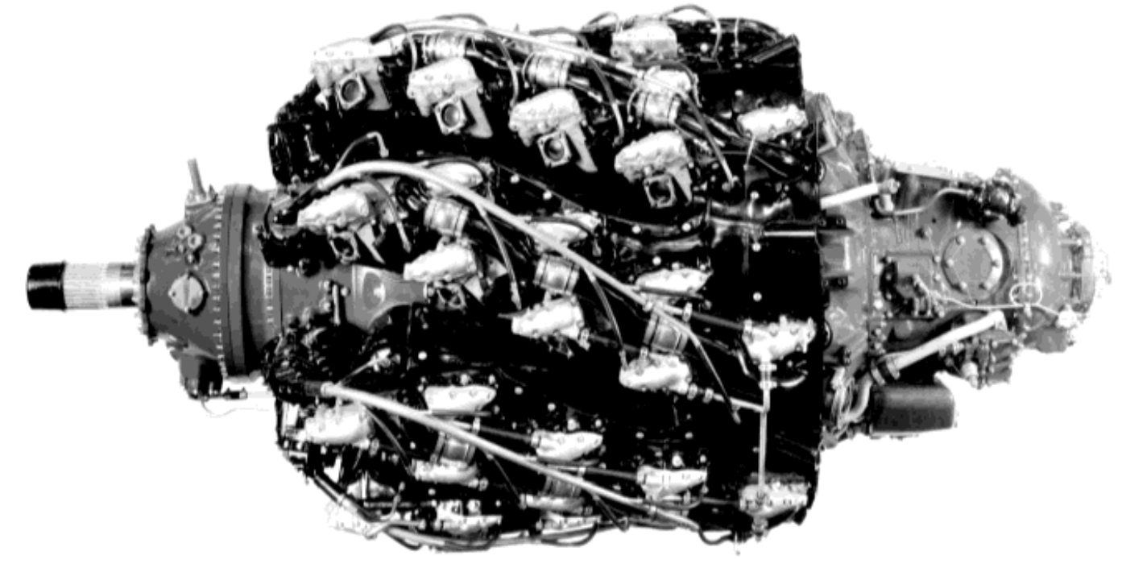
Pratt & Whitney R-4360 Wasp Major – Maciej Stępień
Notes:
Slide 1: Introduction - R-4360 Overview
The engine derives its designation from its displacement volume, which is precisely 4,360 cubic inches, approximately 71.5 litres. The R-4360 Wasp Major, with its twenty-eight cylinders, represents the largest in terms of displacement and the most powerful mass-produced aircraft piston engine. The maximum power output of the most powerful variant was 4,300 HP, equivalent to 3,200 kW. A total of 18,697 units were produced. The engine first ran in 1944. It should be noted that the engine was manufactured in multiple variants intended for different applications. This differentiation is most evident in the variety of supercharging systems, though essentially every engine subsystem varied between variants. In total, there were over 100 different configurations of this engine. Given this quantity and the fact that precise technical information regarding specific variants is difficult to obtain, this presentation focuses on several of the more interesting technical solutions without specifying particular variants.
The engine was developed too late to power World War II aircraft; however, it saw post-war service and proved to be a worthy representative of powerful radial engines, which were gradually becoming obsolete due to the rapid development of turbine engines. The most well-known applications of this engine were the Boeing B-50 Stratofortress and Boeing KC-97 Stratofreighter aircraft.
Engine Specifications:
Air-cooled radial configuration
Cylinder bore: 146 mm
Stroke: 152 mm
Engine length: 2.6 m
Engine diameter: 1.5 m
Dry weight: 1,690 kg
Valve arrangement: Two poppet valves per cylinder
Propeller reduction gearbox: 0.375:1 or 0.425:1
Approximate fuel consumption at cruise conditions: 0.2 kg/hp·hr
The cylinder dimensions were identical to those of the earlier Pratt & Whitney R-2800.

Slide 2
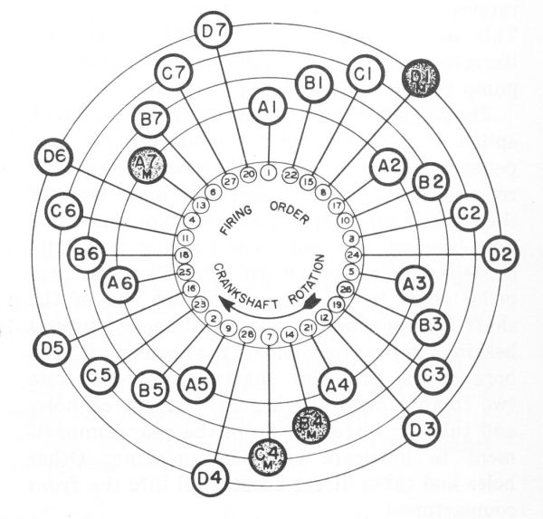
Notes:
Slide 2: Cylinder Arrangement and Cooling Overview
The cylinders are arranged in rows designated by letters A, B, C, and D, where letter D represents the first row closest to the propeller, and A the rearmost row. The firing sequence is visible in the diagram provided.
Like most aircraft engines of that era, particularly radial Wasp Major engines, this engine experienced significant cooling challenges. The first approach to improve engine cooling was to stagger the cylinders by an angular offset of 12.857 degrees between successive rows, ensuring that cylinders were not positioned directly behind one another. This arrangement created the characteristic helical shape, which inspired the engine's colloquial name "corncob"—a reference to a corn cob.
During the R-4360 design phase, Pratt & Whitney developed cast aluminium cylinder head technology, which allowed them to fabricate deep-cut cooling fins with ease. They were no longer constrained by milling limitations. The design target was to maintain temperatures below 260°C.
A phenomenon that could not be overlooked during cylinder head design was so-called "cooling drag." This drag, generated within the engine cowling, is calculated by multiplying the pressure drop across the cowling by the mass flow rate of cooling air. This cooling drag plays a primary role in the total aerodynamic drag generated by the engine—significantly greater than the drag created by frontal areas. It was calculated that approximately 22 kg of air per second would be required to effectively cool the engine at startup power, corresponding to 260 kW of cooling capacity. Given that such cooling was impossible to ensure at startup, it was established that the initial engine operating phase would be cooled passively through heat distribution across the entire engine mass. The cold engine, weighing over 1.5 tons, was required to possess sufficient thermal capacity to provide sufficient time for the aircraft to reach speeds at which optimal cooling conditions would be established.

Slide 3
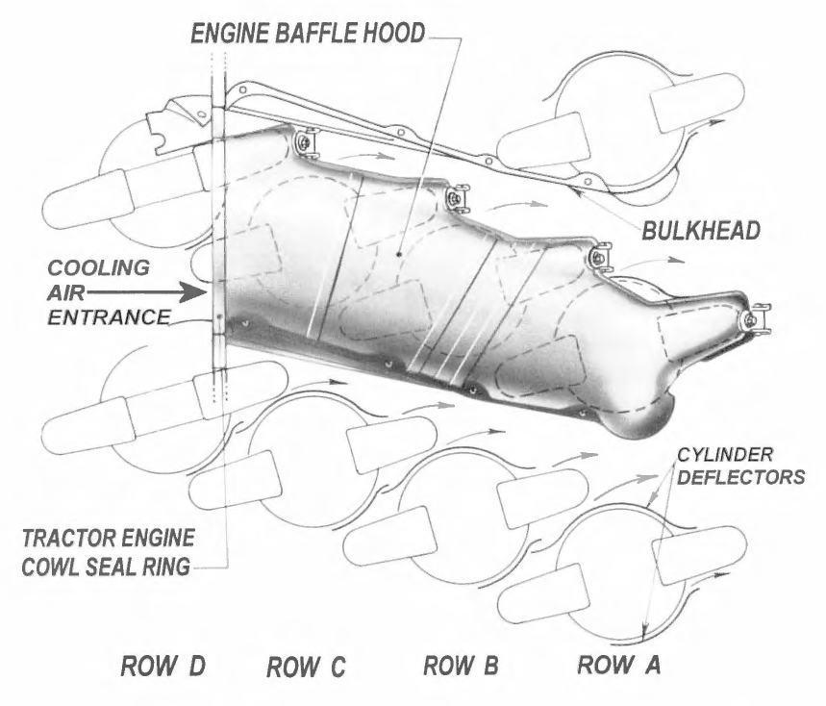
Notes:
Slide 3: Baffling System
During R-4360 development, it became clear that conventional cooling solutions employed in earlier radial engines would not meet the requirements. The standard approach to cooling radial engines of that era was to direct air directly across the cooling fins of the cylinder heads. In the R-4360, it was decided to implement baffles—air ducts directing air to the cylinders at a 30-degree angle.
These baffles completely enclose each of the seven longitudinal rows of cylinders (designated in the diagram as rows A1, B1, C1, D1, and so forth), ensuring that all air entering the engine was optimally utilized for cooling. This arrangement creates separation of cooling between longitudinal rows.
Despite this and other solutions implemented to enable effective cooling, certain operational configurations required the use of an additional fan driven from the main shaft through a reduction gearbox.

Slide 4
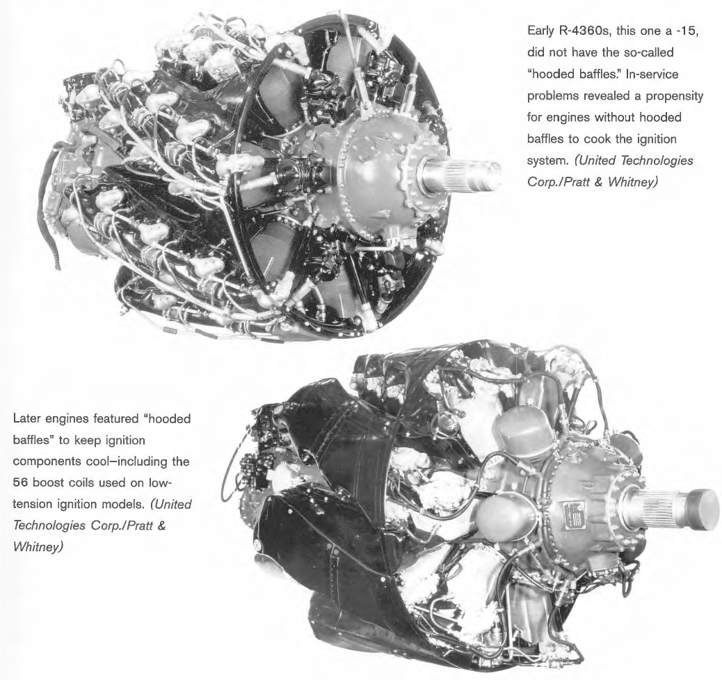
Notes:
Slide 4: Cooling System Evolution
Earlier R-4360 variants did not incorporate the baffling system described above, which resulted in a tendency toward overheating and even ignition system failures. It should also be noted that the development process for the Wasp Major was gradual and meticulous, with each successive variant representing only minor improvements rather than complete redesigns (as was the case with the R-2800, for instance). Observing successive variants, numerous incremental modifications are evident, such as changes to the nose section illustrated above.

Slide 5
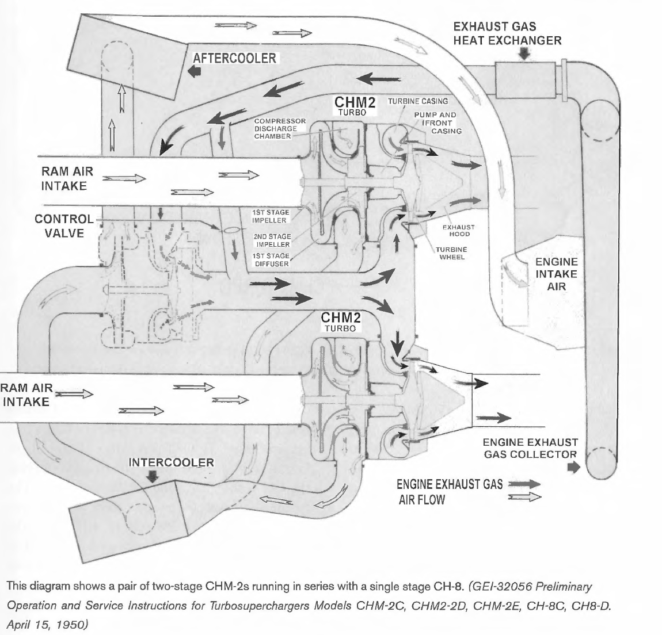
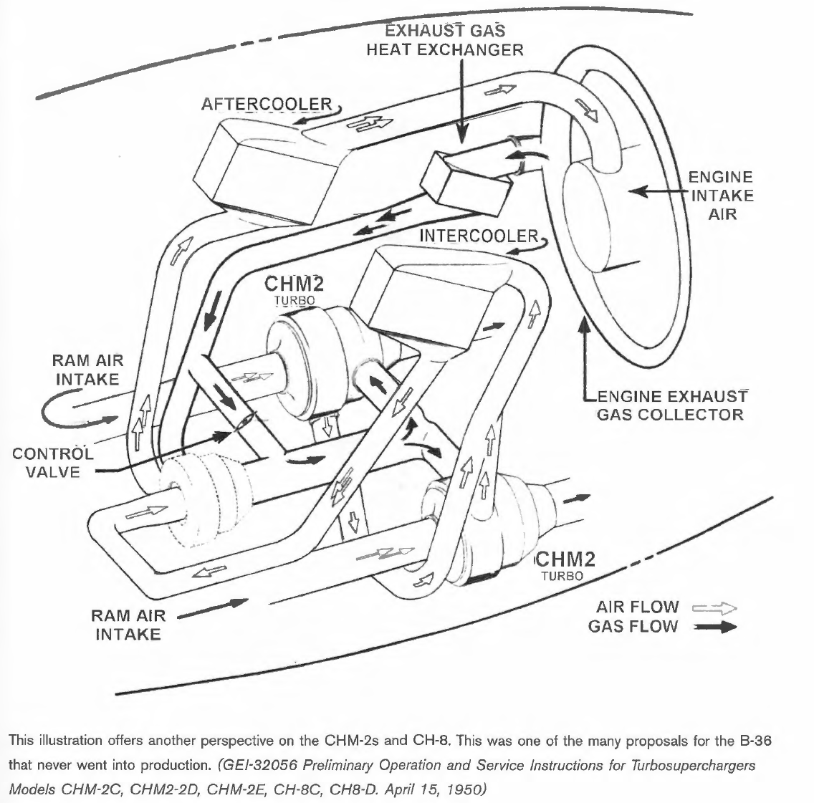
CH8 Turbo
Notes:
Slide 5: Supercharging System Architecture
[Diagram showing top view and isometric view of the supercharging system]
Throughout the various engine variants, the R-4360 was equipped with superchargers, turbochargers, and variable discharge turbine (VDT) systems. All turbos were produced by General Electric, while suppliers of superchargers included both Turbo Engineering Corporation and Lockheed Aircraft.
One of the more interesting supercharging configurations employed two dual-stage centrifugal superchargers (CHM2) and a centrifugal supercharger (CH8) operating in parallel. Exhaust gases first enter the CH8 turbine, with a small percentage bypassing it and flowing directly to the CHM2 superchargers. The quantity of exhaust gas bypassing the CH8 is determined by engine control inputs and aircraft altitude. This bypass flow determines the ultimate air pressure ratio, functioning as a wastegate mechanism.
The energy from exhaust gases, after passing through the CHM2 compressors, is utilized one final time through discharge as a jet of hot gases beyond the engine system, passing through exhaust nozzles.
In Version 55, with this three-turbine charging configuration, the engine could maintain power output on the order of 3,000 HP up to an altitude of 15 km, at which altitude the propeller could no longer be operated with satisfactory efficiency.
The disadvantages of this system were its extreme complexity without digital engine control, large size, complicated construction, and weight. A single CHM2 supercharger alone weighed approximately 260 kg.

Slide 6
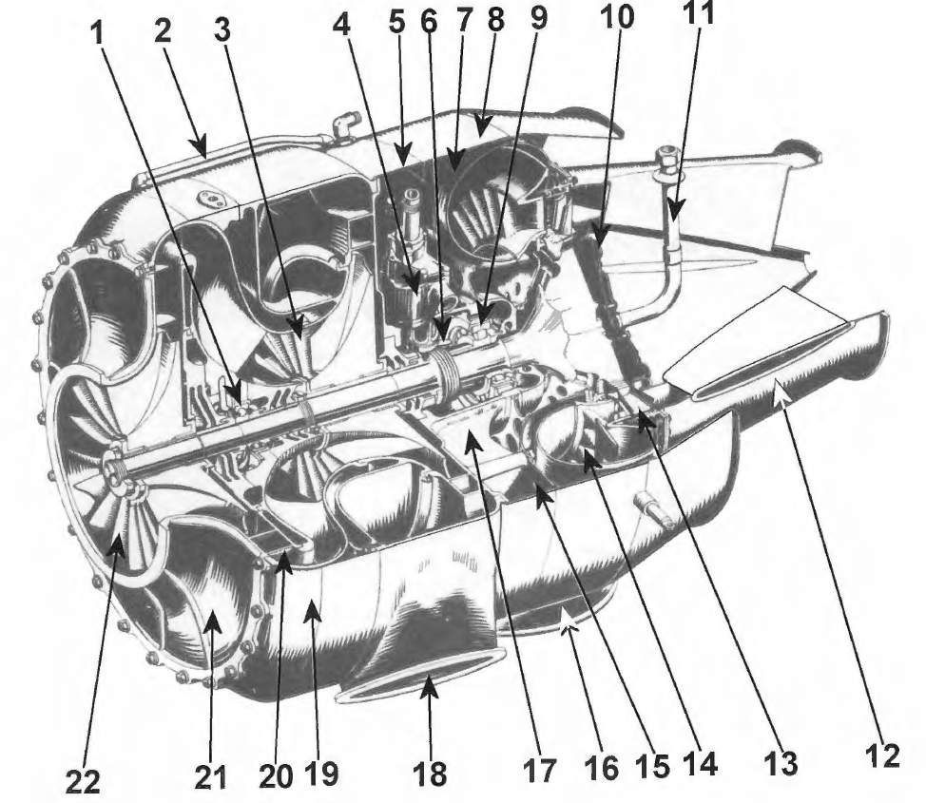
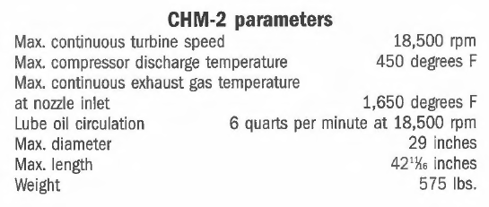
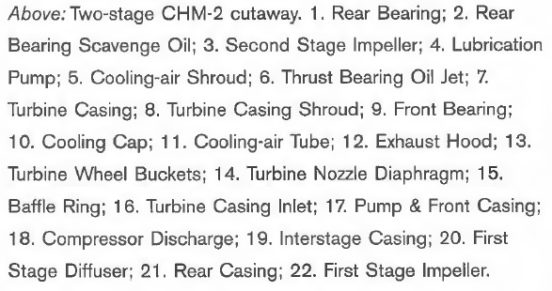
Notes:
Slide 6: CHM2 Dual-Stage Supercharger
[Description of the exit section of the CHM2 supercharger]
Observing the exhaust outlet of the supercharger, a striking similarity to modern turbine engine nozzles is readily apparent.

Slide 7
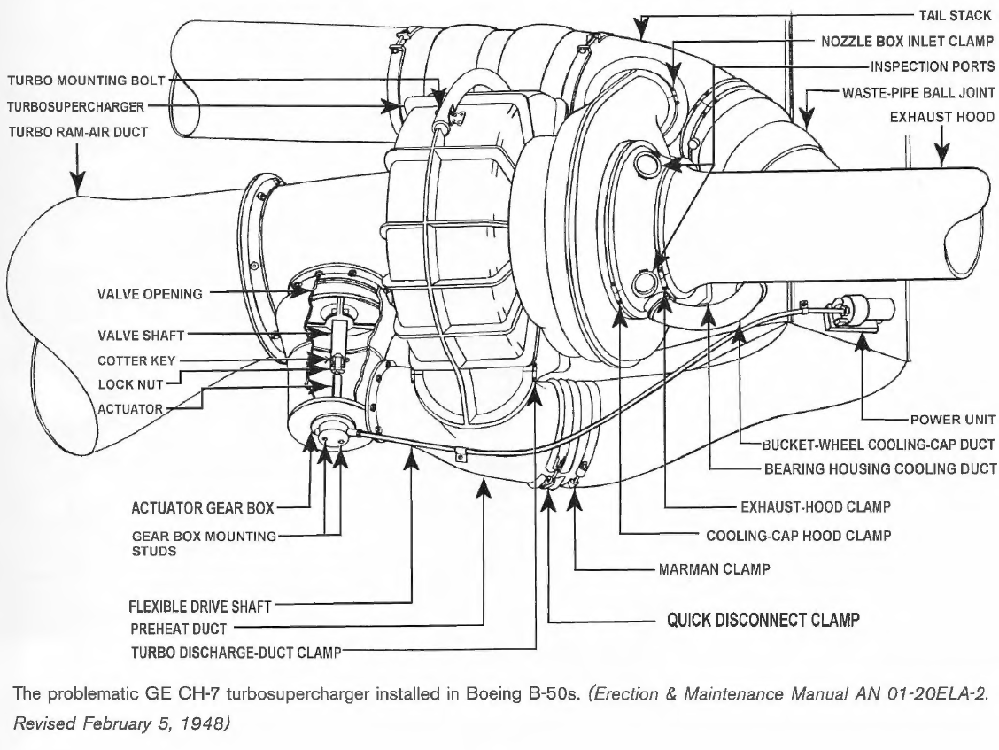
Notes:
Slide 7: GE CH-7 Turbocharger System (B-50 Configuration)
This charging configuration was highly problematic. Issues began with production itself, which—owing to military pressure, cost-cutting measures, and time constraints—was initiated using components from the earlier CH-5 turbocharger model.
This led to numerous problems. Initially, it was discovered that the turbine bucket (rotor blade) was undersized. A pressure discontinuity was observed between the turbine and the nozzle opening, leading to turbine overheating and subsequent deterioration. Consequently, instead of 20,000 RPM, maximum rotational speed was limited to 18,000 RPM, which reduced the engine's ceiling by over one kilometre.
B-50 aircraft equipped with this charging variant had to operate without turbocharger cowlings to improve cooling.

Slide 8
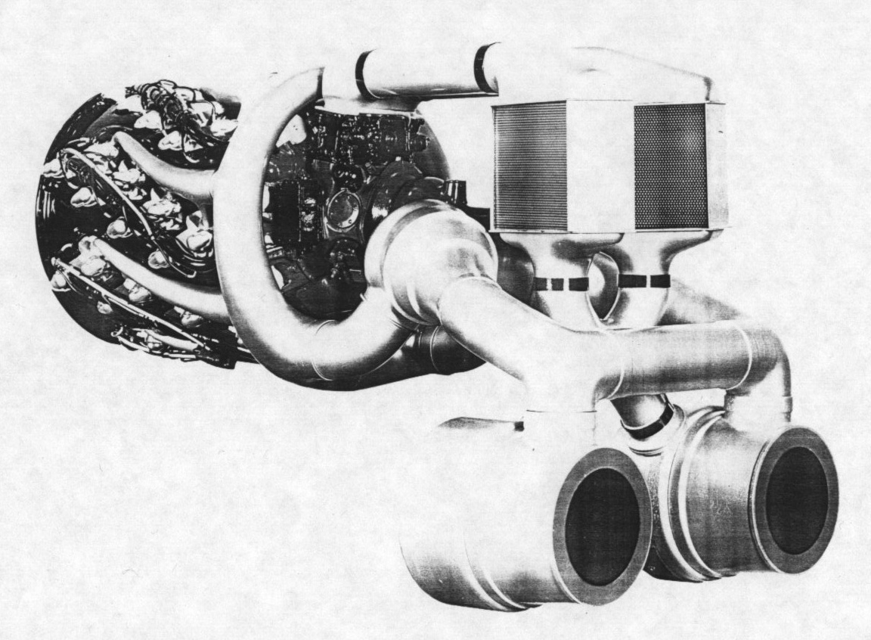
Notes:
Slide 8: Turbocompound Recovery System
In the presented configuration, two superchargers positioned close to the engine drive a shaft transmitting power back to the main crankshaft via a turbocompound mechanism. However, after exiting these two turbines, exhaust gases continue to two additional turbines, which compress air and subsequently deliver it, via an intercooler, to the engine.
While precise calculations were never conducted (to the best of my knowledge), it was estimated that as much as 500 HP could be recovered from the R-4360's exhaust gases alone.

Slide 9
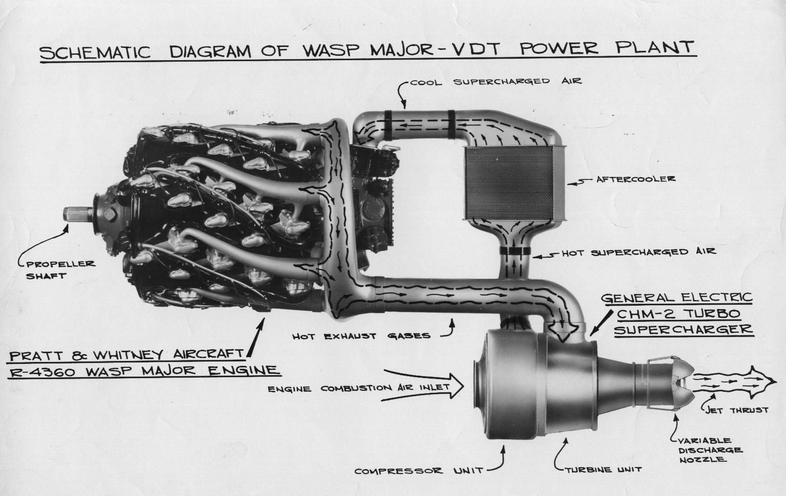
Notes:
Slide 9: Variable Discharge Turbine (VDT) System
An attempt was made to implement a Variable Discharge Turbine (VDT) system in the R-4360. A significant disadvantage of VDT systems was the difficulty in control. While the concept was relatively straightforward, locating an appropriate control methodology proved nearly impossible to implement effectively.
The system employed a hydraulic-mechanical-electrical control system; however, this system never achieved an acceptable level of reliability. The VDT variant underwent several test flights in a modified B-50, controlled manually by flight engineers and pilots, but never achieved operational deployment.

Slide 10
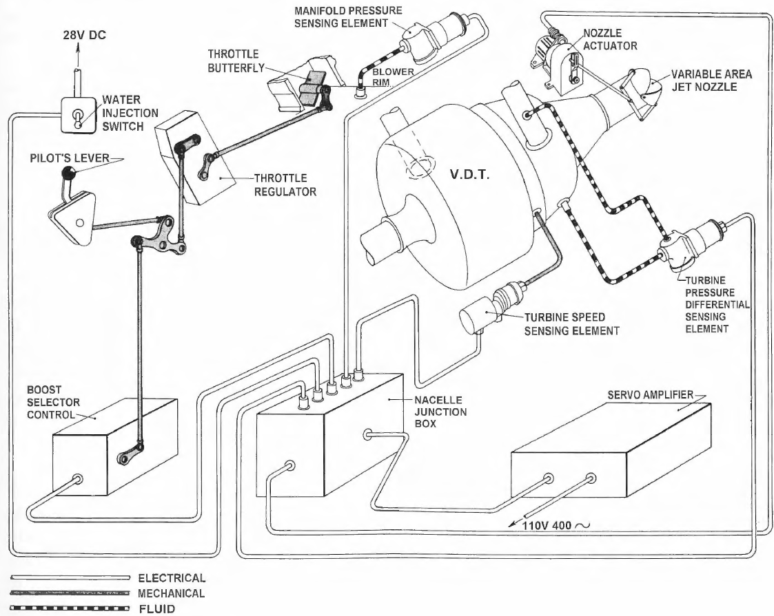
Notes:
Slide 10: VDT Control Schematic
[Control system diagram for Variable Discharge Turbine configuration]

Slide 11
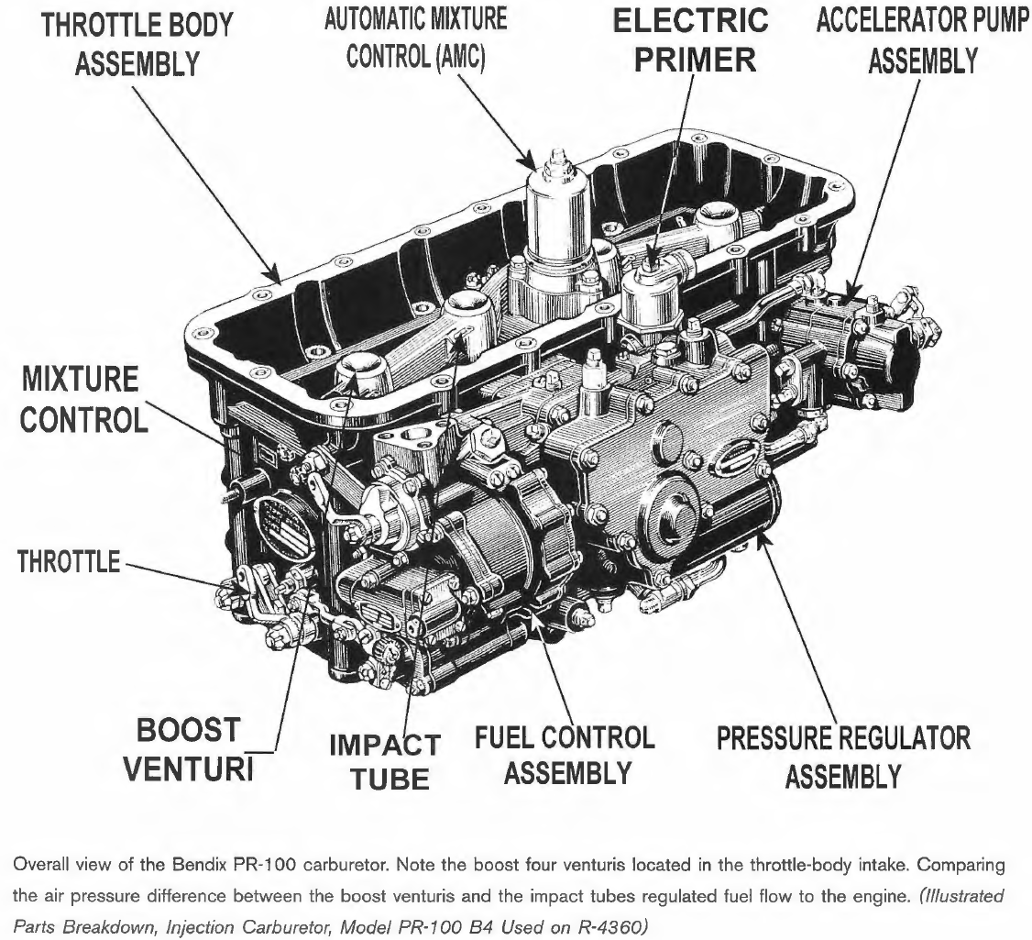
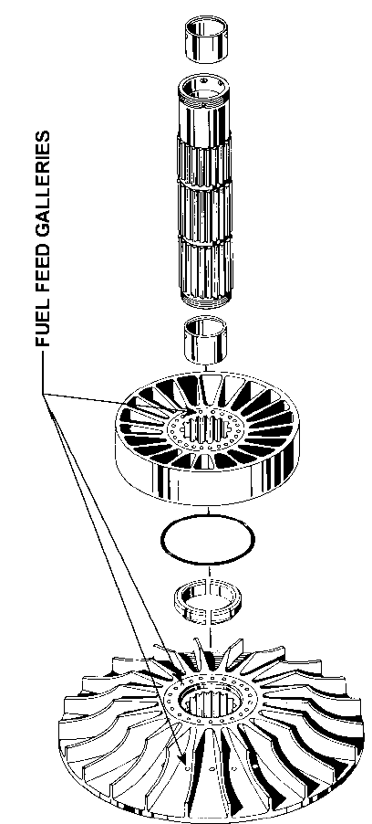
Notes:
Slide 11: Fuel Delivery Systems - Carburetor Configuration
The R-4360 can be categorized into two types based on fuel systems: those with carburetors and those with direct fuel injection. To be precise, direct fuel injection in the Wasp Major refers to direct injection into the cylinder, not to be confused with the Bendix PR-100 carburetor, which is sometimes referred to as an "injection carburetor."
The aircraft manufacturer was required to deliver fuel to the carburetor at a pressure of 20 psi, approximately 1.38 bar. The most commonly employed carburetor in R-4360 engines was the Bendix PR-100.
This carburetor can be divided into five major subsections:
Automatic Mixture Control (AMC)
Fuel Control Unit
Electronic Primer Unit
Regulator Unit
Throttle Body Unit
1. The AMC measures inlet air pressure and communicates this measurement to the Regulator Unit, thereby informing the carburetor of permissible fuel delivery rates. The fuel control assembly contains metering jets, a power enrichment valve, an idle mixture adjustment valve, and a manual mixture ratio regulator directly connected to the regulator assembly, from which it receives unadjusted fuel.
2. Metering throughout the entire idle range is accomplished via an idle mixture adjustment valve mechanically linked to the throttle lever. The power enrichment valve, controlled by a diaphragm, ensures fuel enrichment proportional to the mass flow rate of air through the throttle body.
During water Anti-Detonation Injection (ADI), a pressure relief valve is actuated, reducing fuel flow. Manual selection of appropriate fuel flows for various engine operating conditions is enabled through the lever positions: rich, normal, and manual idle cutoff.
3. The primer unit is responsible for mixture enrichment for engine start. Pressure is supplied by the engine fuel pump, which delivers pure fuel to jets located behind the carburetor toward the cylinders.
4. The Regulator Unit's regulation of inlet air pressure and venturi suction ensure the required pressure differential for automatic fuel draw. Certain engine variants also incorporated centrifugal fuel atomizers, wherein metered fuel was transported through internal passages to the supercharger rotor, where it was discharged centrifugally through small orifices between the rotor blades.
The fuel-air mixture, after passing through the rotor and diffuser, was distributed to the cylinders via seven intake runners—one for each row of four cylinders.

Slide 12
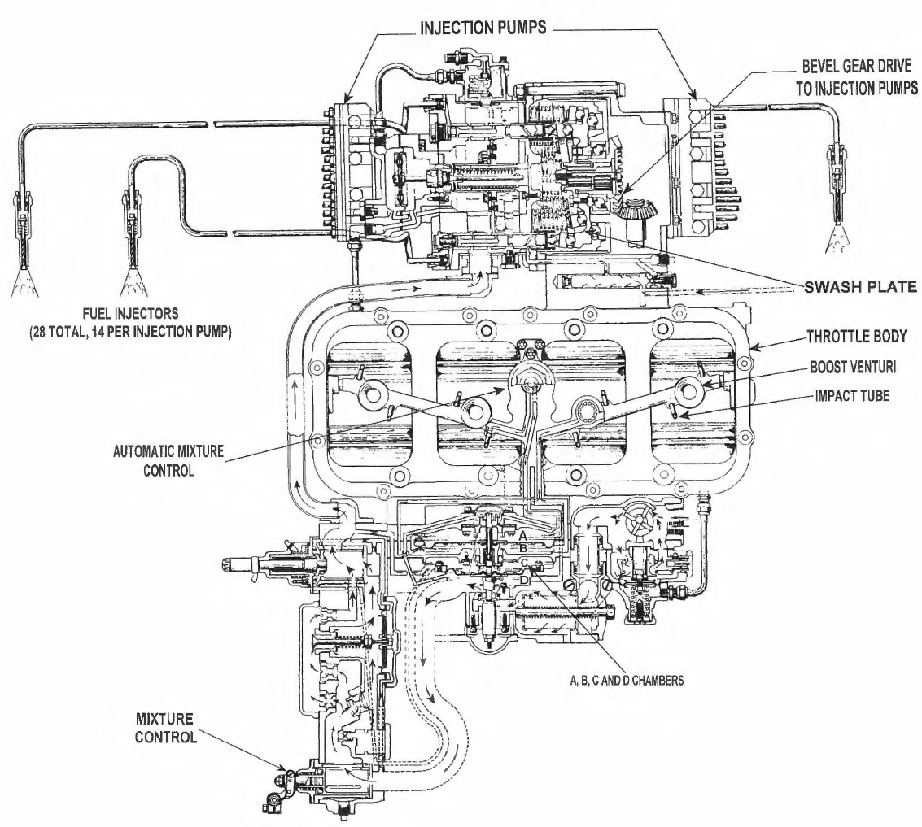
Notes:
Slide 12: Direct Fuel Injection System
Only a small percentage of all produced R-4360 engines were equipped with direct fuel injection. The majority—if not all—of these units were installed in Convair B-36 aircraft.
A significant disadvantage of direct injection is its complex construction compared to carburetor systems. The advantage, however, is uniform fuel distribution to all cylinders. In carburetor engines, uneven fuel distribution could lead to uneven cylinder heating.
The injection system employed was the Stromberg 100-28-A. This system occupied the same space typically reserved for the carburetor in alternative designs. Fuel is injected at 500 psi (34.5 bar) pressure during the intake stroke. Similar to its carburetor counterpart, manual mixture selection is available in rich, normal, and idle cutoff (no fuel) settings.

Slide 13
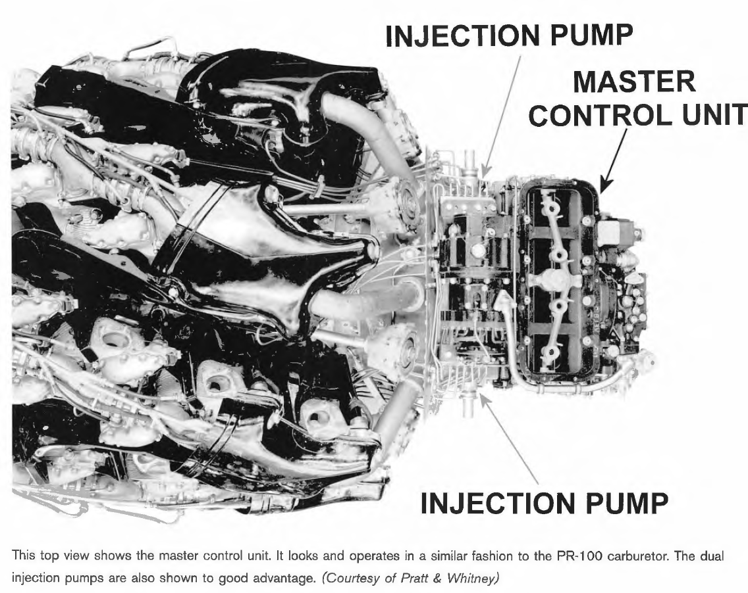
Notes:
Slide 13: Water Anti-Detonation Injection (ADI) System
The R-4360 also incorporated water injection—more accurately, a 50-50 mixture of water and alcohol, with alcohol primarily serving as antifreeze protection. This system is also known as Anti-Detonation Injection (ADI).
The purpose of ADI is to cool the fuel-air mixture and cylinder to suppress or eliminate detonation during high-power engine operation, such as during take-off.
The use of ADI during normal low-load operation, such as cruise conditions, provided minimal benefit. ADI can be likened in effect to a temporary increase in fuel octane number. The fuel mixture burns in a more controlled manner.
ADI can guarantee as much as 500 additional HP in the Wasp Major engine, though the water injection itself does not increase engine power. This power increase results from the fact that, following combustion chamber cooling, operation at higher inlet air pressures becomes possible than without water. Increased air pressure provides greater power output and improved engine efficiency.
Water injection installation requires certain safety provisions. Should water supply be exhausted, the engine must immediately revert to dry operating conditions. For this purpose, mixture richness valves are employed. Potential accelerated corrosion must also be considered.

Slide 14
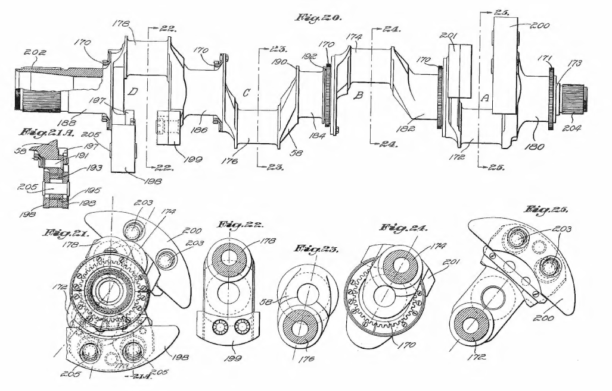
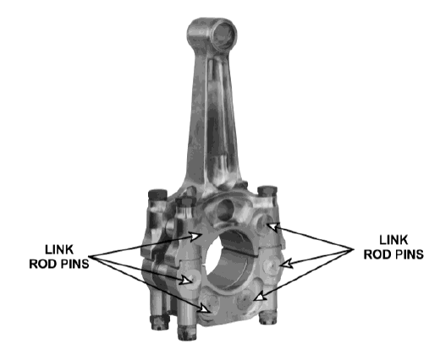
Notes:
Slide 14: Crankcase and Valve Mechanism
Cylinders were constructed from forged aluminum cylinder heads with deeply cut cooling fins and integrated valve mechanism housings, bolted and shrunk onto forged steel cylinder barrels. Aluminum sleeves were fitted onto the cylinders, into which deeply cut cooling fins (muffs) were threaded.
Each cylinder contains one intake valve and one exhaust valve, both seated in steel inserts. Cylinders are arranged helically around the crankcase, with pressure bulkheads provided for individual cylinders. For each row of four cylinders, baffle plates are provided to ensure proper cooling of all cylinders. All cylinders are fully interchangeable.
Pistons, forged from aluminum, are of the pent-roof type with reinforced internal wrist pin bosses. Each piston is equipped with three compression rings, two control rings (piston expanders) for oil scraping, and one oil scraper ring. The upper compression ring is chromium-plated on the sealing surface.
The master rod for each row of seven cylinders features a cover in which a two-piece tin-silver lead-lined bearing with a shim is seated. Six articulating connecting rods with I-section profiles, each with bronze sleeves at both ends, are attached to the master rod via silver-plated wrist pins (articulating pins).
The single-piece crankshaft is manufactured from forged steel. It features four crank throws and is supported within the crankcase by five main bearings of steel with tin-silver-lead liners. Four counterweights provide counterbalancing for rotating and reciprocating masses.
Two of these counterweights are fixed; the remaining two are equipped with bifilar dynamic vibration dampers. The propeller shaft is supported on the crankshaft side by a conventional tin-lead-bronze bearing and on the propeller side by a roller bearing for radial loads and a ball bearing for axial loads.
The crankcase casting assembly comprises five sections, all of which, except the front and rear, are essentially similar. Crankcase sections are manufactured from aluminum forgings and are joined by threaded through-bolts. All remaining crankcase sections are magnesium castings.
The magneto section, mounted on the front of the crankcase assembly, contains the torquemeter and mounting pads for either seven earlier-model magneto spark plugs or four later-model spark plugs. In the nose section, positioned forward of the magneto section, is located the planetary reduction gearbox, with provisions for a full-authority propeller speed governor.
The reduction gearbox reduction ratios are 0.375:1 or 0.425:1.

Slide 15
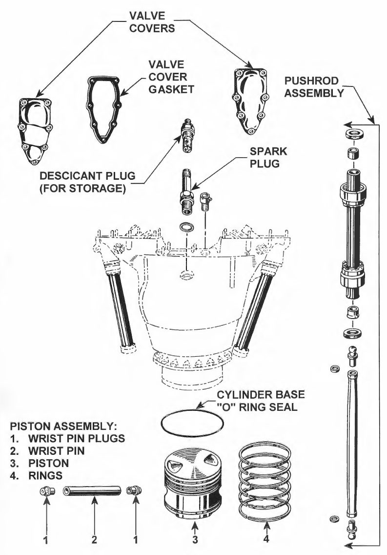
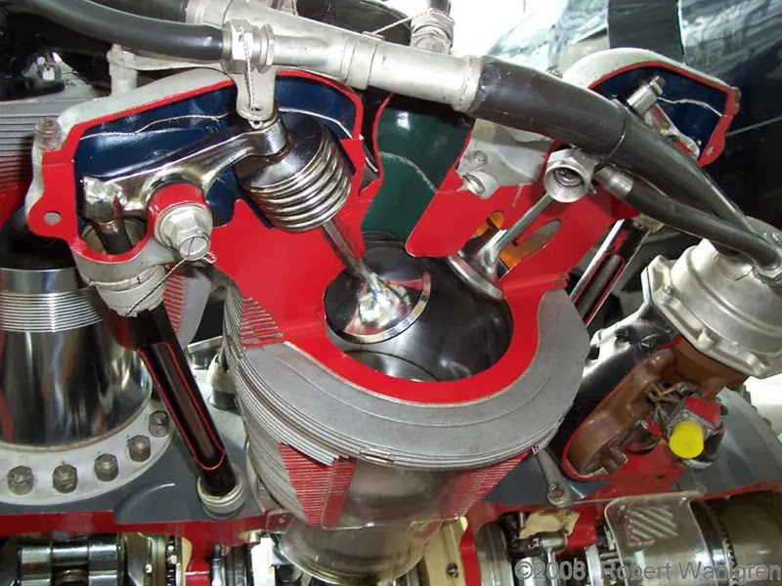
Notes:
Slide 15: Valve Arrangement and Exhaust Valve Control Challenges
Each cylinder contains two poppet valves. Preceding the R-4360, most aircraft engine cylinders incorporated intake and exhaust valve lifters positioned at the front or rear of the cylinder. In the R-4360, the intake valve housing and lifter were located at the front of the cylinder, while the exhaust valve housing and lifter were positioned at the rear. This arrangement required a fifth camshaft along with associated complexities in drive and lubrication; consequently, designers determined that the advantages outweighed the disadvantages. This decision had unintended consequences—the longer valve lever arms were more flexible than in previous engines, resulting in unprecedented cylinder damage.
To achieve good volumetric efficiency and exhaust scavenging, it is important that the exhaust valve opens before bottom dead center of the power stroke. However, during this process, significant residual pressure—up to 100 psi (6.9 bar)—persists within the cylinder. This residual exhaust pressure opposes the closed exhaust valve, and with a valve seating area of approximately 5.4 square inches, a force of 500 pounds (2.2 kN) is required to overcome the exhaust gas pressure.
Beyond exhaust gas pressure, an additional valve spring force of 900 pounds (4 kN) is necessary. Furthermore, additional force is required to accelerate the valve actuation assembly, which operates at a mechanical disadvantage. Summing these forces, Pratt & Whitney engineers determined that the initial opening force of the exhaust valve exceeds 4,220 pounds—nearly 18.7 kN.
In a structure subjected to such stresses, the valve system began to exhibit elastic deformation characteristics.
As the valve lifter roller traversed the camshaft profile, residual exhaust pressure resisted exhaust valve opening. Something had to yield; accordingly, the exhaust valve lever arm flexed until sufficient force was developed in the system to release the accumulated pressure and force the valve open. When the valve opens, it opens violently, bouncing the exhaust lifter off the camshaft profile.
Simply installing stiffer valve springs was not an effective solution. In reality, this only exacerbated the problem. Careful reinforcement of the valve lever bosses in areas where they extended above the cylinder helped, but the situation remained marginal. Additional solutions included camshaft profile modifications. As a starting point, the same profile employed in the R-2800 was utilized. Subsequently, a gentle ramp was designed to gradually relieve the exhaust valve from its seat. To overcome these and other challenges, the United States Air Force conducted extensive tests with various valve clearances.

Slide 16
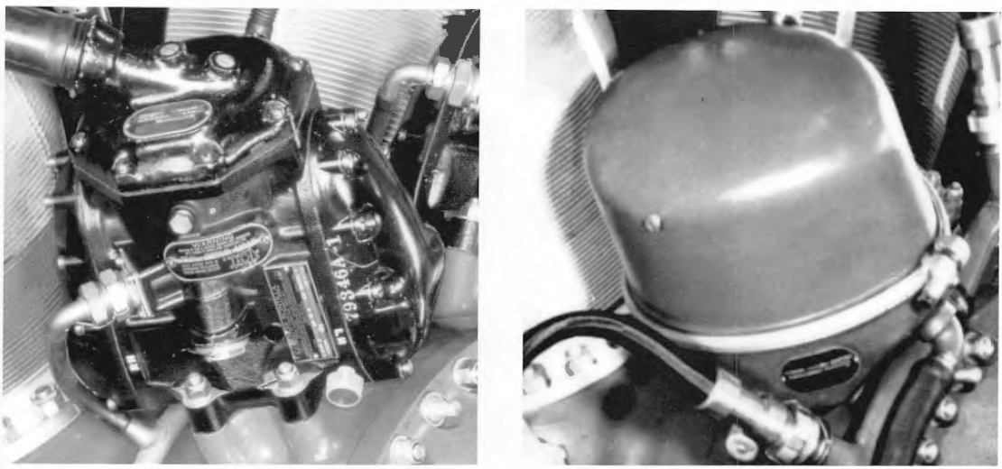
Notes:
Slide 16: Ignition System
The ignition system in early engines comprised seven high-pressure magnetos fitted with spark plugs. The left photograph depicts one of seven high-voltage spark plugs mounted at the engine front. Each spark plug supplied one row of cylinders. This was a complex ignition system, prone to desynchronization at higher operating altitudes.
Air from the turbocharger was directed to the spark plugs to increase pressure, which to a certain degree assisted in reducing misfires.
Each magneto provided dual ignition for a series of four cylinders positioned directly behind it.
Later engines employed four low-tension spark plugs (visible in the right photograph)—Bendix Scintilla S14RN-15 with integrated distributors operating at one-twelfth crankshaft speed. This was a simpler solution that performed better at high operating altitudes.
The spark plugs on the left side of the engine are designated L1 and L2:
L1: Upper left magneto, fires intake plugs on cylinder rows B and D
L2: Lower left magneto, fires intake plugs on cylinder rows A and C
The magnetos on the right side are designated R1 and R2:
R1: Upper right magneto, fires exhaust plugs on cylinder rows A and C
R2: Lower right magneto, fires exhaust plugs on cylinder rows B and D

Slide 17
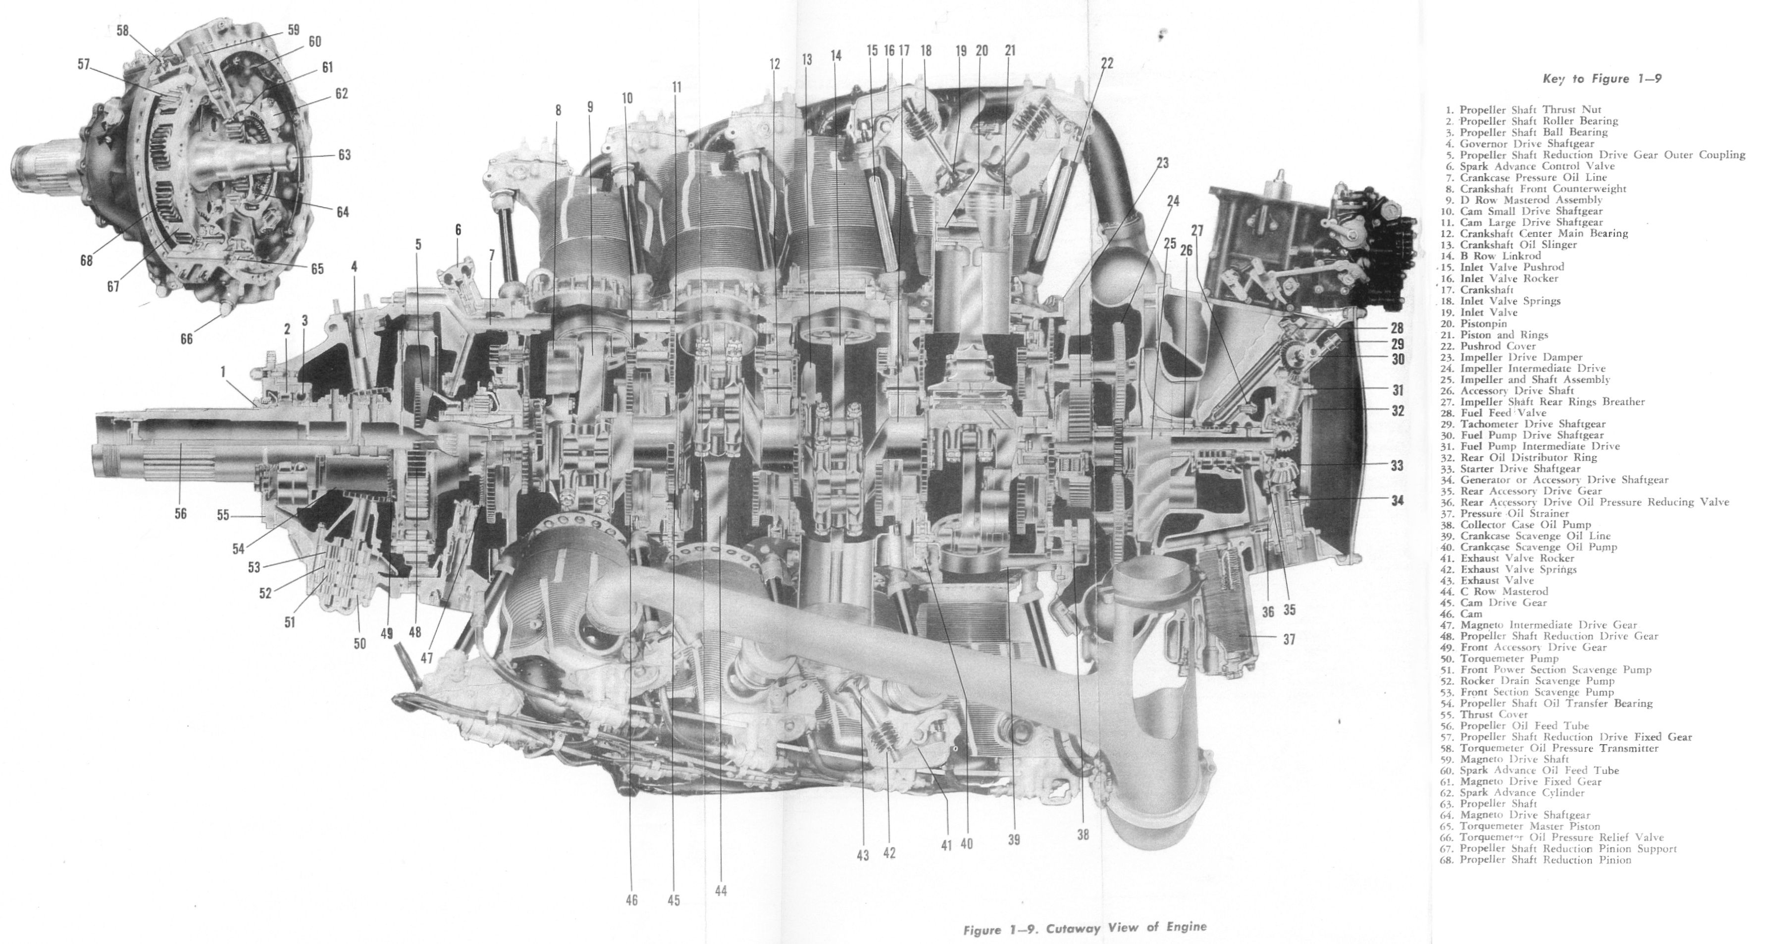

Slide 18
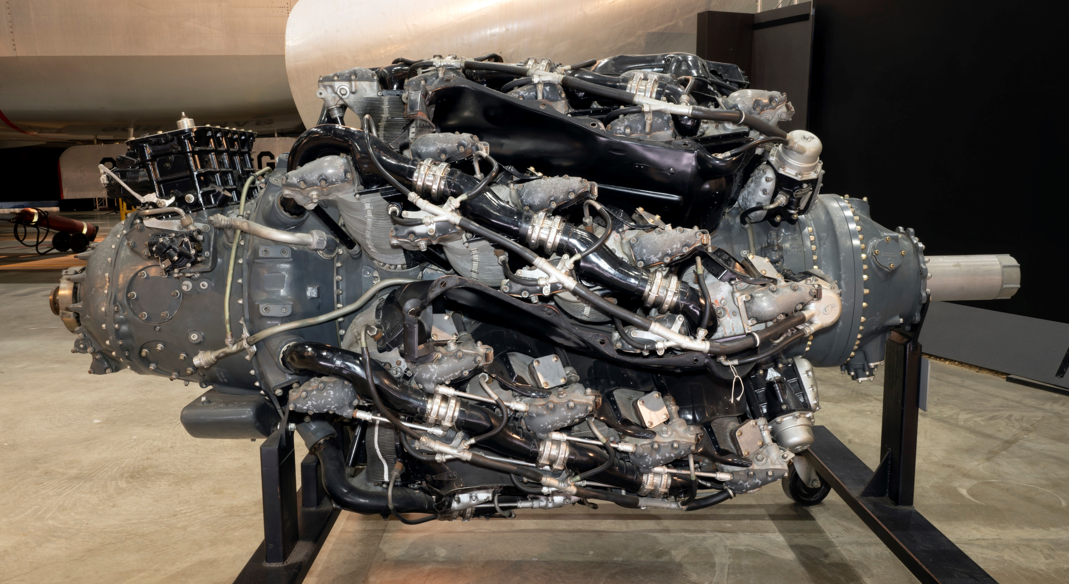

Slide 19
Sources
White, Graham (2006). R-4360: Pratt & Whitney's Major Miracle. North Branch, Minn.: Specialty Press
https://www.engineerine.com/2021/10/pratt-whitney-r-4360-28-cylinder-engine.html
The Piston Engine Revolution: A conference at The Museum of Science and Industry, Manchester, 14-17 April 2011
https://en.wikipedia.org/wiki/Pratt_%26_Whitney_R-4360_Wasp_Major#Variants
Aircraft Engines by Naval Air Technical Training Command

Slide 20
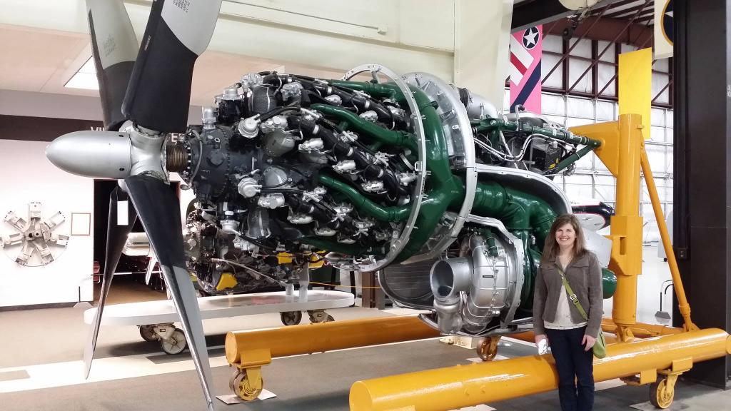
Notes:
Scale of the engine as compared to a person.

